Slide 1

Secure Infrastructure
Design and Server
Placement
Week 2: from business requirements to a defensible design proposal
SCQF Level 8 / HND
Checkpoint 1
Freeman Industries Secure Infrastructure Project

Slide 2
Where Week 2 fits
1
2
3
4
Understand
Design
Justify
Evidence
Read the scenario and identify business, operational and security requirements.
Decide where roles, servers and trust boundaries should sit.
Explain how the design reduces risk and supports the organisation.
Submit a diagram, server estate, risks and placement rationale.
Checkpoint 1: design proposal

Slide 3
From problem to design decision
Problem
Requirement
Design decision
Control evidence
Freeman Industries has local accounts and inconsistent password settings.
Central identity, enforceable policy and auditable administration.
AD DS domain with domain controllers placed inside the protected server segment.
Diagram, server estate, account model, policy matrix and later AD DS tests.
Professional standard
Avoid isolated statements such as “install a server”. Show the reason, the alternative, the chosen control and how it will be proved later.

Slide 4

Security-by-design
Design questions to answer early
Which services are critical to the organisation?
Where are the trust boundaries and high-value targets?
What traffic should be allowed, restricted or monitored?
How will a compromised account or server be contained?
How will the design be maintained, tested and documented?
Level 8 link
You should compare realistic alternatives, recognise limitations and justify why the chosen design is suitable for Freeman Industries.

Slide 5
Confidentiality, integrity and availability
!
Confidentiality
Integrity
Availability
Only authorised people and systems can access sensitive information.
Information and configuration remain accurate and trustworthy.
Services remain usable when staff need them.
Example: Finance/HR data isolated with group-based permissions.
Example: controlled administration, change records and tested policies.
Example: resilient DNS/DHCP, backups, monitoring and recovery planning.
Apply CIA to each placement decision
A server can be technically working but badly placed. The design should show how each important role protects data, configuration and service continuity.

Slide 6
Attack surface and role separation
Attack surface
Role separation
Every installed role, open port, management interface and privileged account is a possible route in.
A minimal server build should run only what is required for its agreed purpose.
Unneeded services are removed, disabled or isolated.
Avoid placing unrelated high-value roles together without a reason.
Separate identity, file services, management tools and public-facing services where practical.
Use the design to contain failure, compromise and operational mistakes.
Poor design: one overloaded server running everything
Better design: roles placed to match risk and recovery needs

Slide 7

Physical and logical placement
Physical placement
Server room, rack security, power, cooling and access control.
Protection of domain controllers, backup media and recovery keys.
Risks from theft, tampering, environmental failure and poor documentation.
Logical placement
Network segment, firewall rules, allowed management path and service exposure.
Whether the server is internal, management-only, DMZ-facing or isolated.
Whether virtualisation improves flexibility without weakening separation.

Slide 8
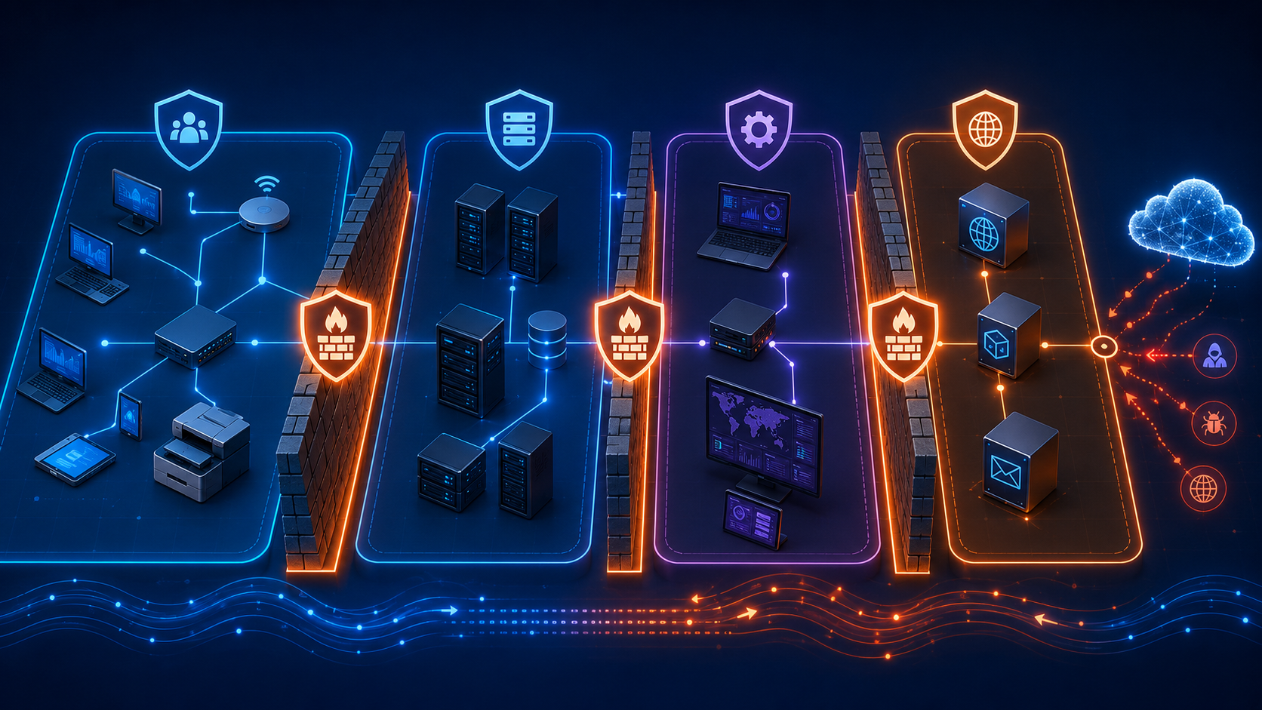
Segmentation and trust boundaries
What segmentation is doing
Groups systems with similar security needs.
Restricts unnecessary traffic between zones.
Makes monitoring and troubleshooting clearer.
Limits lateral movement after compromise.
Supports separate management and user paths.
Freeman Industries example
User workstations, internal servers, management systems and public-facing services should not all sit in one unrestricted flat network.

Slide 9
Perimeter and DMZ concepts
DMZ
Internal
Network
Internet
Perimeter
Firewall
Internal
Firewall
Web / reverse proxy
limited inbound services
AD DS, DNS, DHCP, files
not internet-facing
Design judgement
A DMZ is not “secure because it is separate”. It is useful because the allowed traffic, exposed services, logging and management routes are deliberately controlled.

Slide 10
Freeman Industries: proposed zones
!
User zone
Server zone
Management zone
DMZ / perimeter
Department PCs and laptops
Standard users only
No direct admin paths
AD DS, DNS, DHCP
File services and storage
Backups and internal records
Admin workstation
Monitoring and scripts
Privileged access route
Public website or proxy
TLS and logging
Restricted inbound rules

Slide 11
Building the server estate
Role
Likely placement
Security reason
AD DS / DNS
Protected server zone
High-value identity service; limited management access.
DHCP
Protected server zone
Authorised service; supports controlled addressing.
File services
Internal server/storage zone
Sensitive data protected by groups, audit and quotas.
Admin tools
Management zone
Reduces routine use of admin credentials on user devices.
Website / proxy
DMZ or isolated application zone
Public exposure separated from internal services.
Do not just list servers
A Level 8 server estate explains purpose, placement, dependency, exposure, data sensitivity and recovery importance.

Slide 12
Windows Server 2025 edition and servicing choices
Standard
Datacenter
Suitable where a small number of Windows Server instances are needed.
Often a sensible starting point for small or controlled lab deployments.
Decision should still consider growth, virtualisation and licensing constraints.
Better fit for highly virtualised or software-defined datacentre scenarios.
Relevant when storage, networking or virtualisation features justify it.
Choice must be explained against business need, not simply “more is better”.
LTSC planning point
Windows Server 2025 is a Long-Term Servicing Channel release. Design notes should include how the selected platform will be patched, supported and maintained across the project lifecycle.
Portfolio link
Record the chosen edition, installation type and role-placement decision. Your explanation should reflect the lab build and the larger Freeman Industries design.

Slide 13
Availability and resilience in design
Single point of failure
Redundancy
!
Which service stops the business if it fails?
Where is a second server, backup service or recovery path needed?
Recovery evidence
Operational limits
How will you prove recovery works rather than assume it?
What does the lab simulate, and what would production require?
Freeman Industries examples
AD DS, DNS, DHCP, file storage, backups and the customer information website all need availability decisions. Some will be implemented later; Week 2 records the initial design intent.

Slide 14
Risk register at Level 8
Risk
Likely impact
Initial control
Future evidence
Shared admin account
No accountability; broad compromise
Named elevated accounts and separation
Account model and admin tests
Flat network
Fast lateral movement after compromise
Segment users, servers, DMZ and management
Logical diagram and firewall tests
Unapproved software
Malware and unstable systems
Policy restrictions and approved deployment
GPO tests and user guidance
Insecure documentation
Attackers gain a roadmap
Access-controlled and redacted documents
Storage plan and evidence index

Slide 15
Diagramming expectations
Your diagram should show
Your diagram should avoid
Users, servers, networks and any perimeter/DMZ area.
Where AD DS, DNS, DHCP, file services and website roles sit.
Trust boundaries, security zones and expected traffic paths.
A naming convention and enough detail to match the server estate.
A single flat LAN with no explanation of separation.
Ambiguous icons that do not map to real server roles.
Unlabelled connections and unmanaged internet exposure.
Sensitive information such as passwords, keys or real personal data.
Assessment standard
The diagram is not decoration. It is product evidence that should support your placement rationale and risk controls.

Slide 16
Practical design workshop
Re-read the scenario
1
Highlight requirements, problems and constraints.
Draft the zones
2
User, server, management and DMZ/perimeter areas.
Place the roles
3
AD DS, DNS, DHCP, files, website and admin tools.
Create the risk register
4
Risk, impact, control and future evidence.

